Slide 1

Digital Transformation
3 really big trends, a triple jump, and lots of questions to ask yourself
Tim Cole
Internet-Philosopher
Salzburg/Munich
BOA Varna 070618

Slide 2
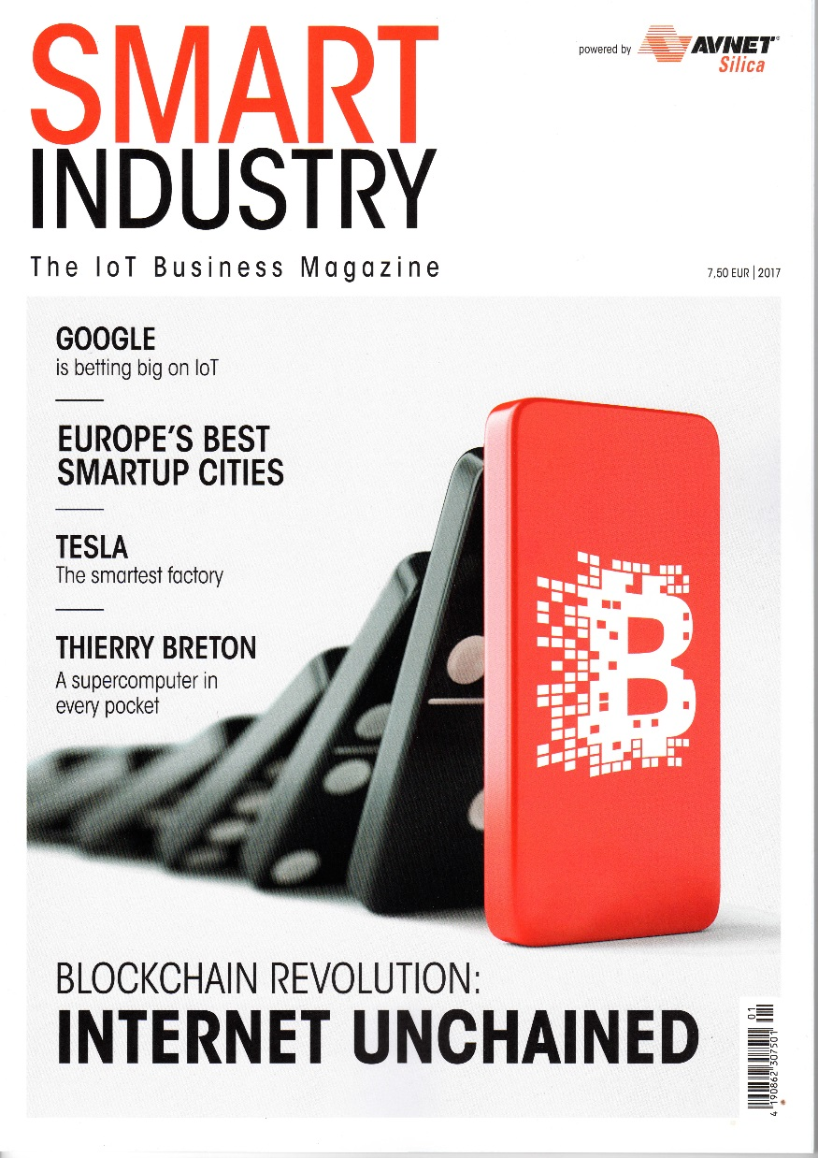
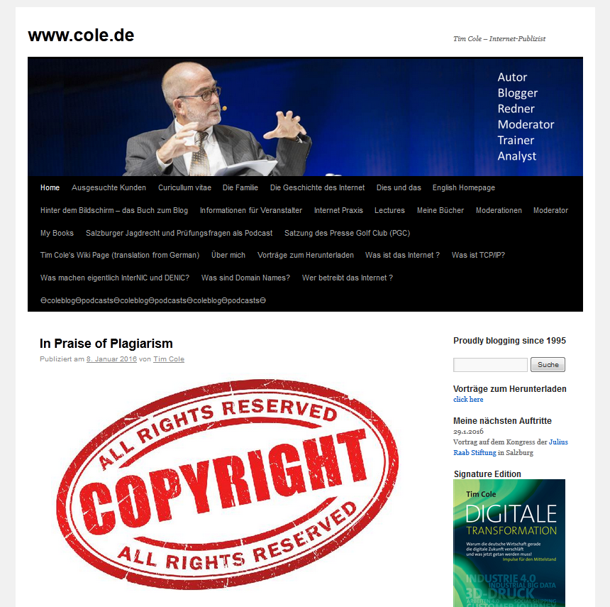
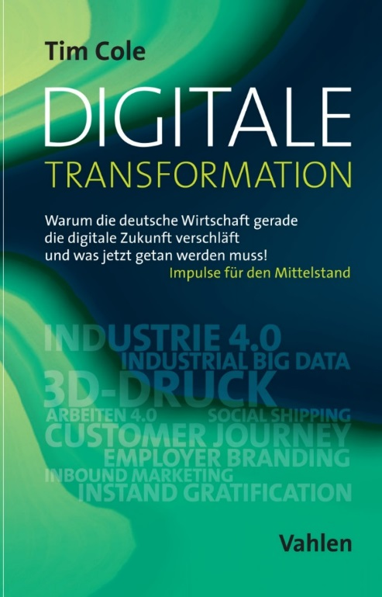

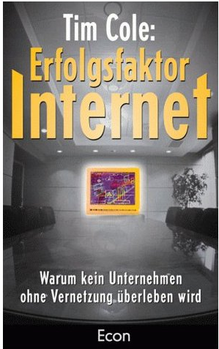

Slide 3

3 really big trends

Slide 4
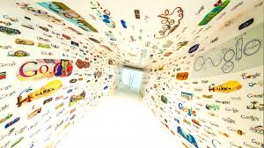
Digitalisation

Slide 5
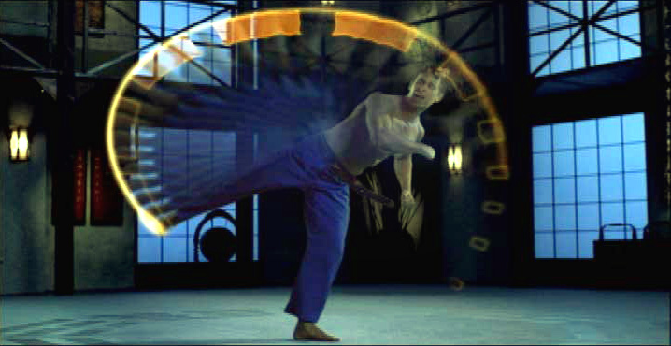
Digital acceleration

Slide 6
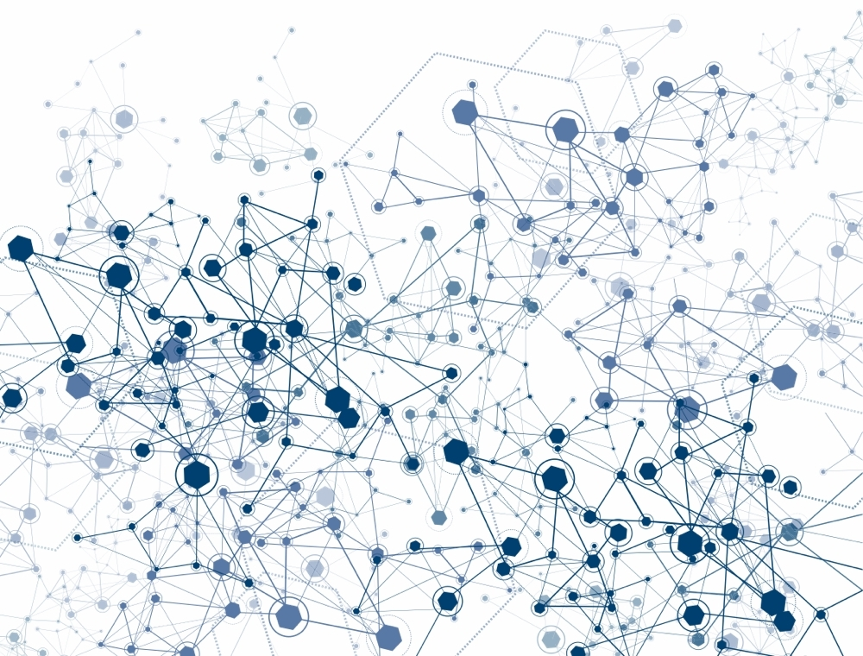
CONNectiVITY

Slide 7
























“Right Information, Right Place,
Right Time”
CUSTOMERS
CUSTOMERS
PARTNERS
EMPLOYEES
SUPPLIERS
Notes:
Organizations seeking to use the web to generate competitive advantage.
Competitive advantage derived from better sales, better customer satisfaction, better internal and external efficiencies
These improvements come from better knowledge and process sharing across BU’s, and with C, P, S.

Slide 8
Work in progress:
Bridging Digital Islands
Intranet
Web
E-Commerce
CRM
Data Mining
SCM
E-Procurement

Slide 9
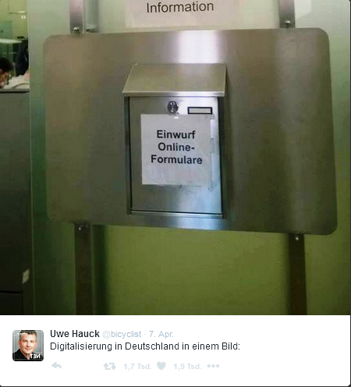
drop off online
forms here

Slide 10

MobilitY

Slide 11

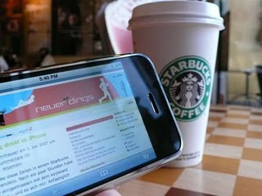

Slide 12
DigitaliZATION
CONNECTIVITY
MobilitY

Slide 13

Digital Transformation

Slide 14
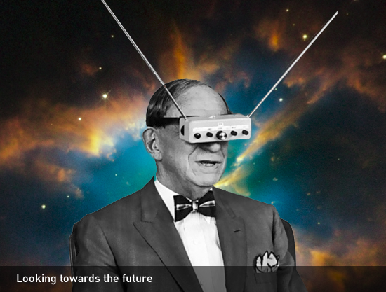
Seeing the world through other eyes

Slide 15
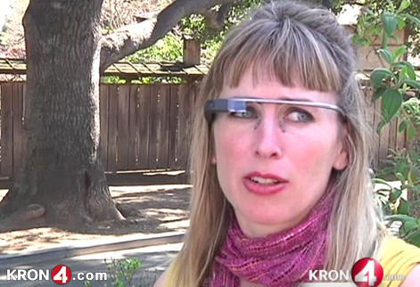

Slide 16

Disruption!

Slide 17
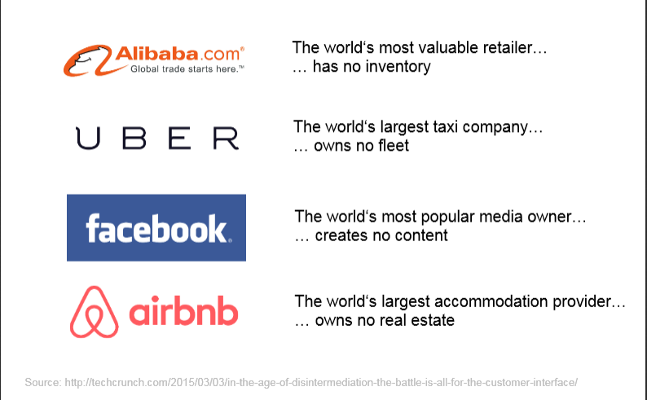

Slide 18
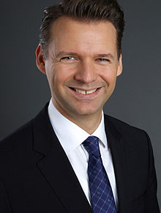
„Kollmann‘s Law“
Prof. Tobias Kollmann
Uni Duisburg-Essen
Which smart young kids in Silicon Valley with
a great idea and loads of venture capital are
thinking right now how to put you
out of business?

Slide 19
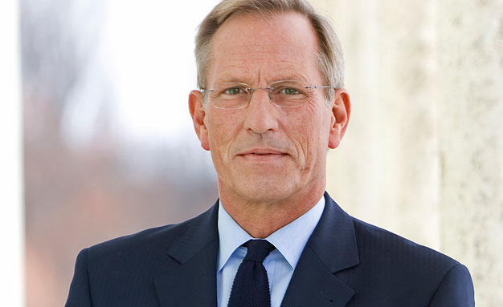
„Become a digital enterprise“
Michael Diekmann
CEO Allianz Group 2003-2015

Slide 20
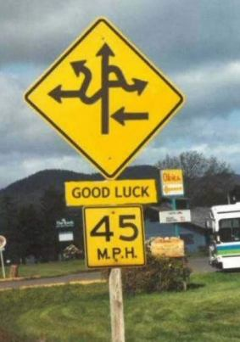
Reduce Complexity!

Slide 21

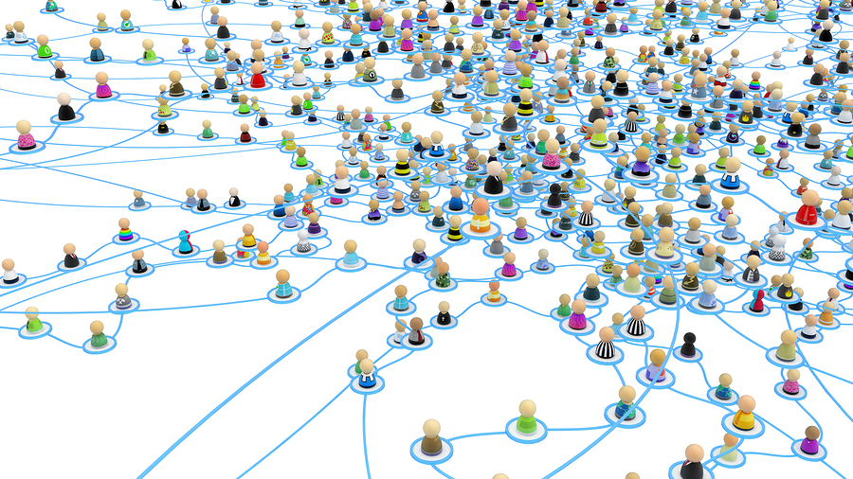
Deconstruct Hierarchies!

Slide 22
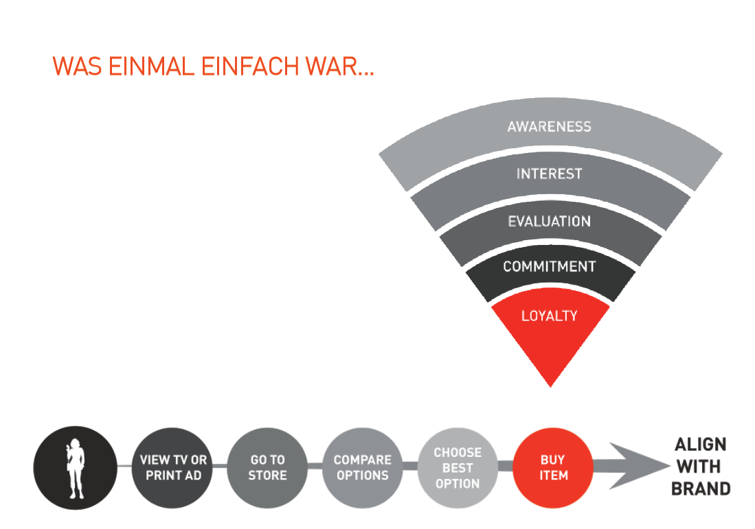
Value Chain (old model)

Slide 23
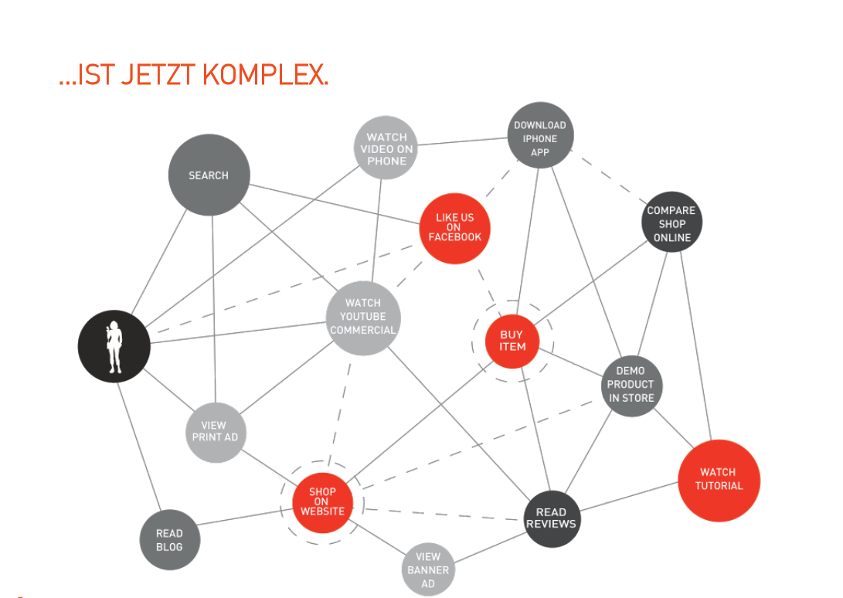
Value Chain (new model)

Slide 24
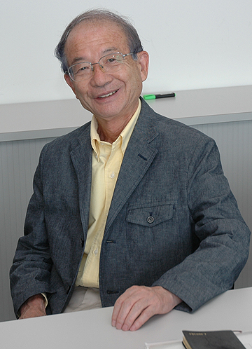
Level the knowledge field!
“The work in project groups with shallow or no hierarchy encourages dialogue and the exchange of tacit knowledge.”
Prof. Ikujiro Nonaka

Slide 25
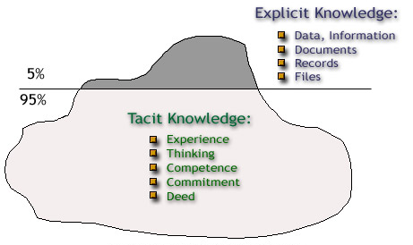
Tacit knowledge is personal, context specific, and therefore hard to formalize and communicate.
Explicit or codified knowledge refers to knowledge that is transmittable in a formal systematic language.

Slide 26
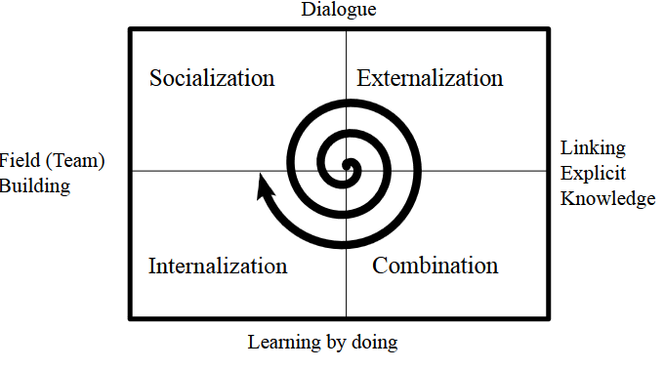
SECI
Tacit
Tacit
Tacit
Explicit
Tacit
Explicit
Explicit
Explicit
Source: Nonaka, I./Toyama, R./Konno, N.: SECI, Ba and Leadership: A Unified Model Of Dynamic Knowledge-Creation.

Slide 27
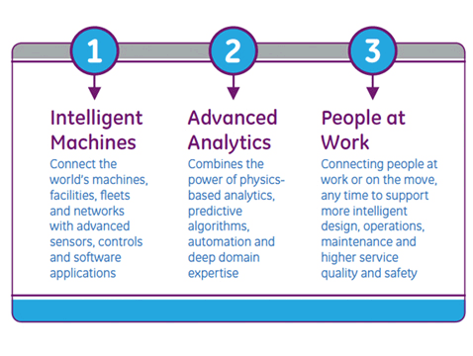
What is a digital enterprise?

Slide 28
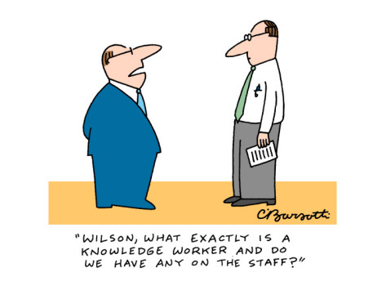
Hire Knowledge Workers!

Slide 29
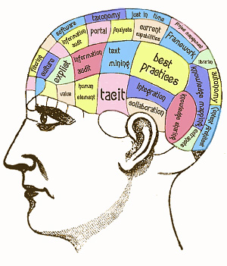
“… work mainly with information or … develops and uses new knowledge to do their jobs.”
Peter Drucker, Landmarks of Tomorrow, 1959

Slide 30

What makes a Knowledge Worker?

Slide 31

Certain age

Slide 32
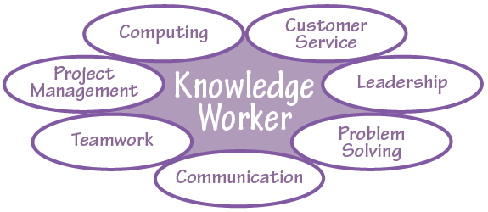
Is at home in many areas…

Slide 33

… uses new tools …

Slide 34
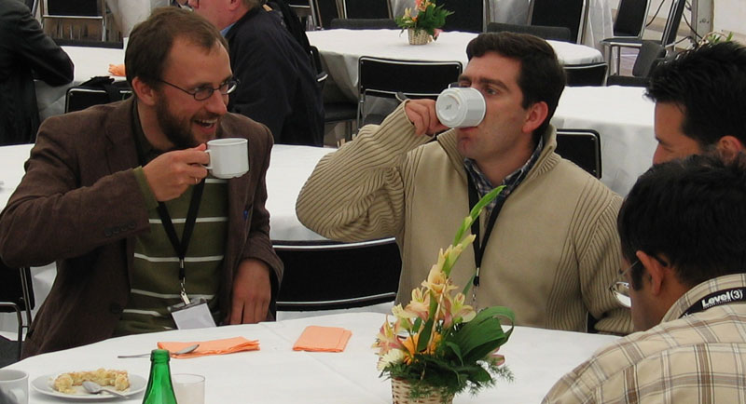
… shares information gladly and freely …

Slide 35
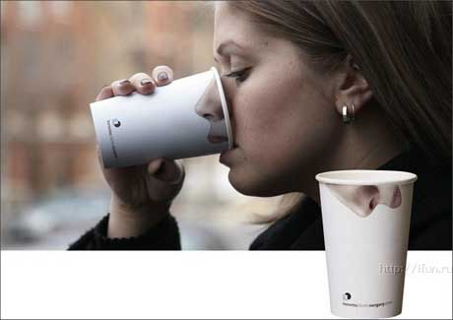
… is highly creative …

Slide 36

… isn’t afraid of new ideas …

Slide 37

….. Is always looking for new things.

Slide 38
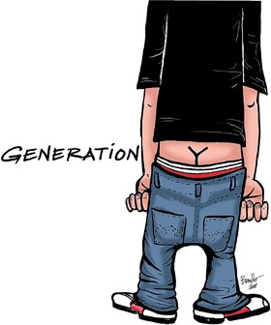

Slide 39
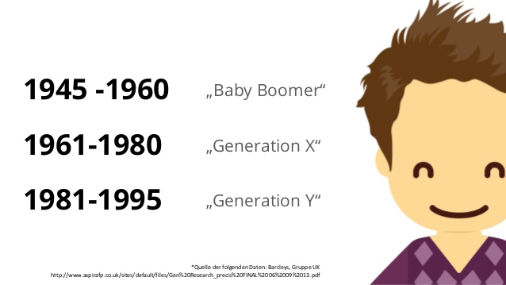
Bevölkerungskohorten
Notes:
Bevölkerungskohorten
Schon im Jahr 2015 wird der Anteil der Generation Y an der erwerbstätigen Bevölkerung bei 30% liegen (Quelle: destatis.de) In 2020 wird die Generation Y 50% der weltweiten Arbeitskräfte stellen (Quelle: PWC).

Slide 40
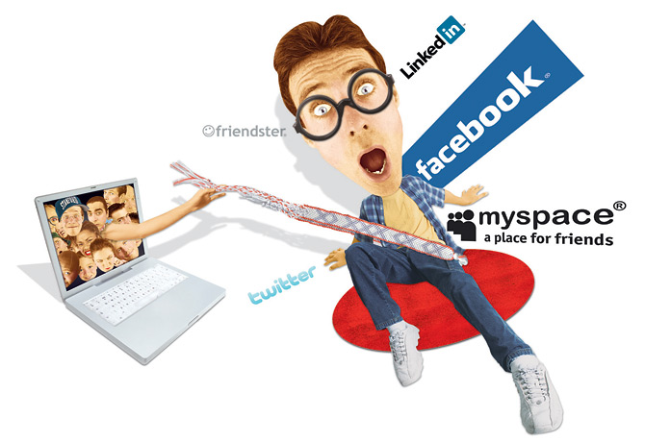

Slide 41
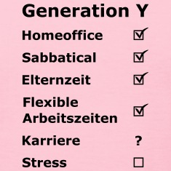
Parental leave
Flexible work schedules
Career

Slide 42
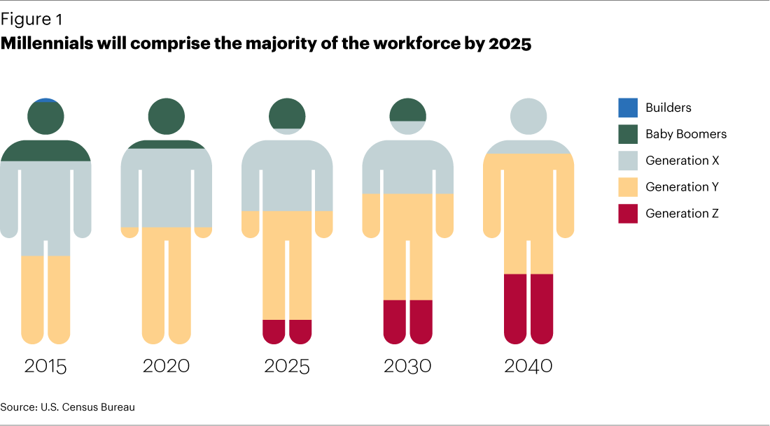
Why is this important?

Slide 43
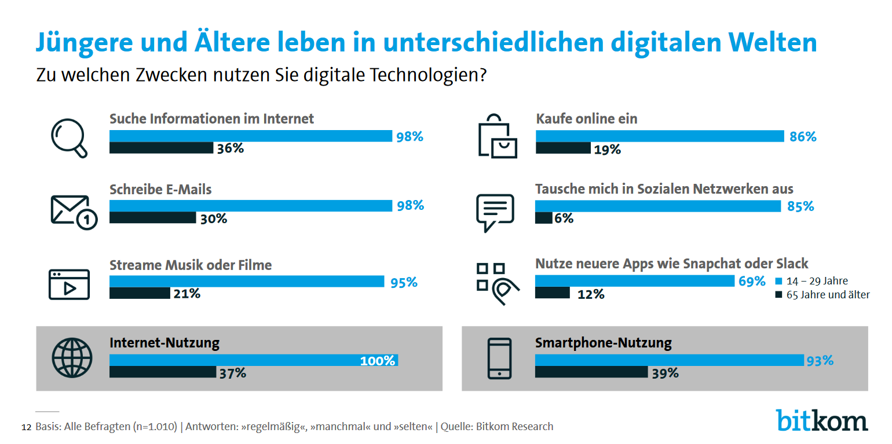
Old and young live in different worlds
What do you use digitale technologies for?
Search for information online
Make purchases online
Write emails
Surf the social web
Stteam music or videos
Use apps like Snapchat or Slack
Use the Internet
Use a smartphone

Slide 44
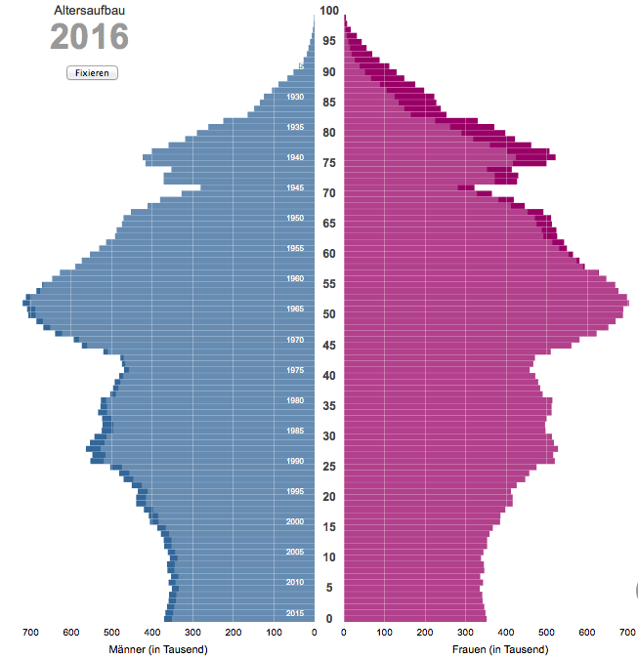

Slide 45
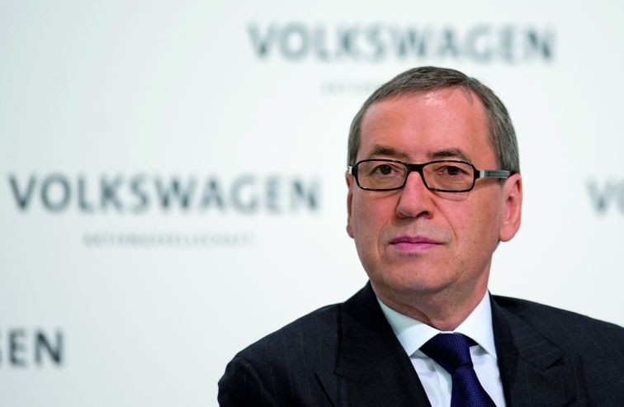
„I have no idea how to replace all the baby boomers that are going to retire soon. The well is dry!“
Prof. Horst Neumann, Head of HR, Volkswagen AG

Slide 46
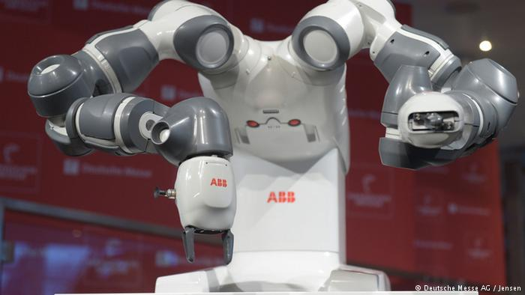


Automation
Zuwanderung
Qualifikation

Slide 47
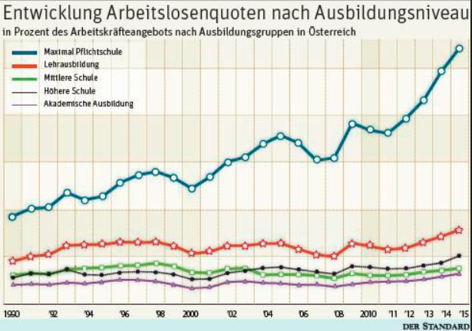
Link between education and unemployment

Slide 48

„Two strong arms are not enough for a modern-day warehouse worker – he also needs to be able to use the warehousing software“*
*Dr. Johannes Kopf, CEO, Austrian State Employment Agency AMS.

Slide 49


Slide 50
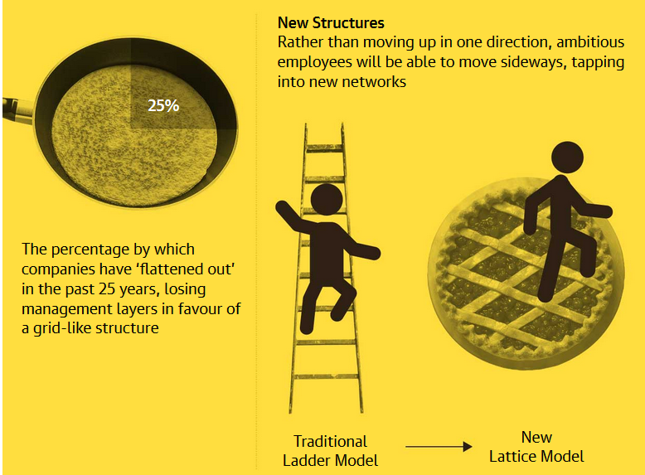
Lattice vs. ladder
Notes:
Forget the rigid corporate ladder – now the corporate lattice allows free-flowing ideas and career paths
In the lattice organisation you can find growth by doing different roles, so you have new experiences, you acquire new skills, you tap into new networks.
This might involve hot-desking, ideas workshops and regularly switching teams.
Large corporations are starting to emulate small startups to attract talent

Slide 51
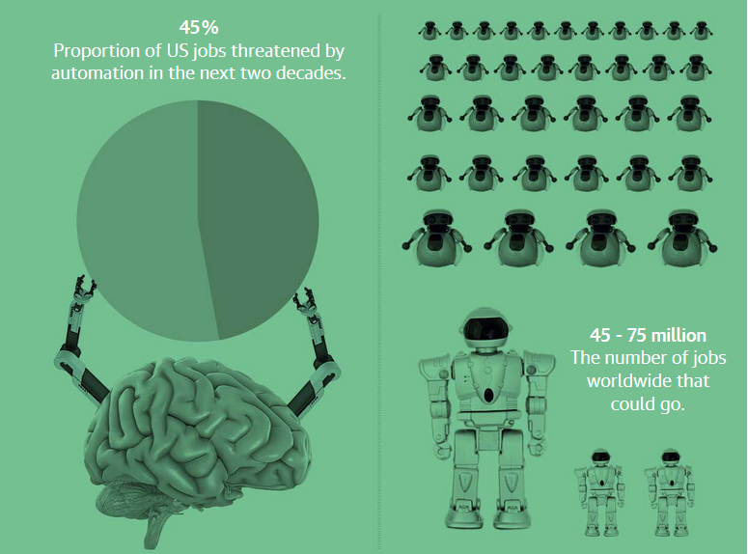
Robots want your job
Notes:
Oxford Martin School 47% of jobs in the US.
Avoid routine, repetitive and predictable
“If you’re digging a ditch or painting a house, laying pipes or setting bricks – anything that involves basic hand-eye co-ordination – there will be low-cost, efficient mechanical devices that can do that work,”

Slide 52
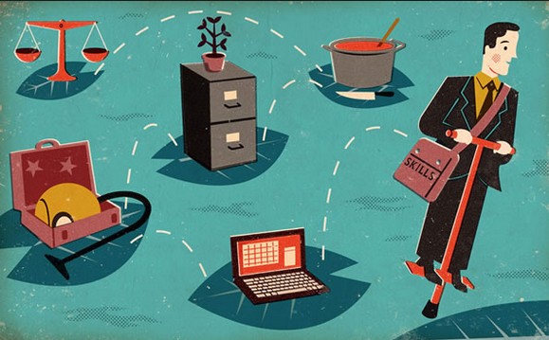
Job hopping: the new normal

Slide 53
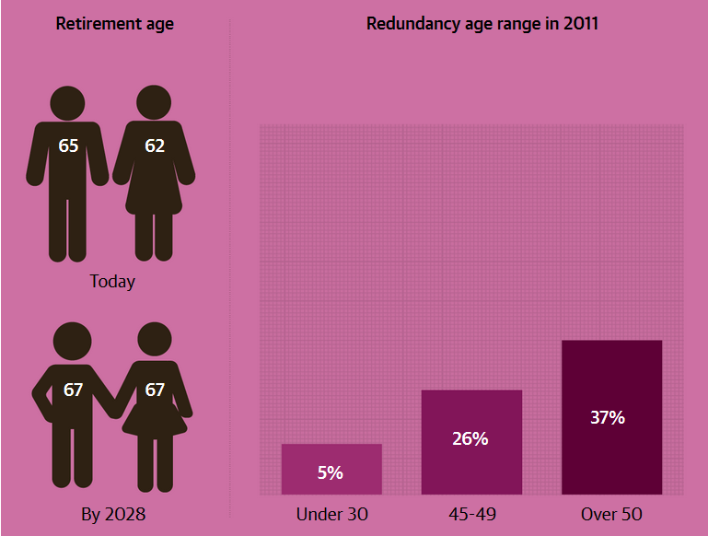
The end of retirement
Notes:
This pressure comes from governments, which struggle to afford pensions for a longer-living population, and also from individuals themselves, who find it harder to make their retirement savings stretch as the average life expectancy
older worker with sought-after skills can manage transitions from one job to another easily enough, but for those in low-skill, physically demanding jobs, having to work longer than you planned can be quite scary.

Slide 54

The „gig economy“

Slide 55
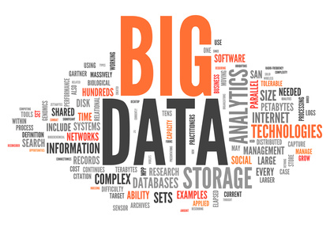

Key Takeaways
CUSTOMERS
CUSTOMERS
PARTNERS
EMPLOYEES
SUPPLIERS
Right Information., Right Time, Right Place
As much information as possible
Become a Knowledge Worker!
Leadership by networking

Slide 56
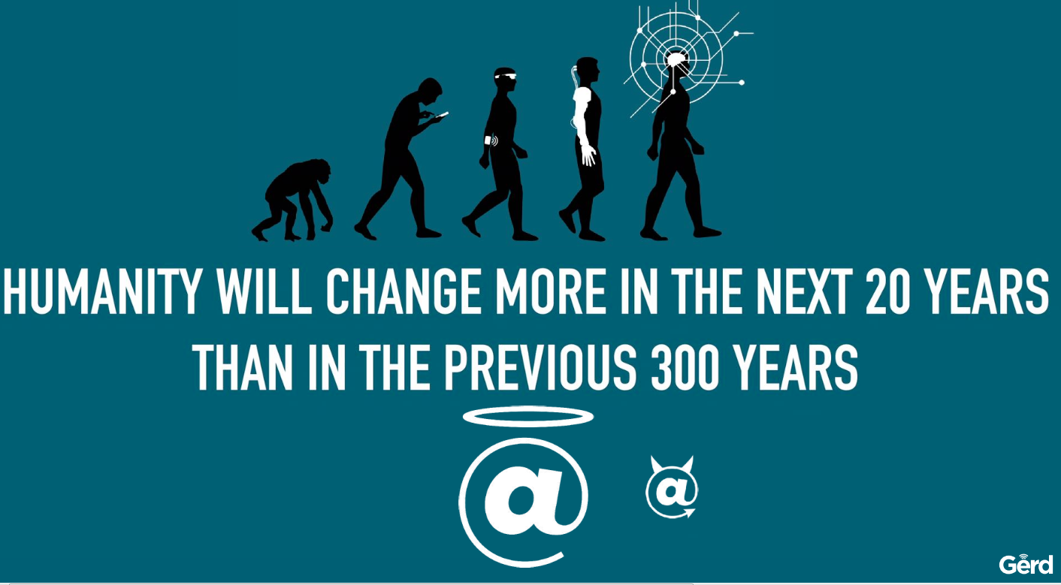

Slide 57


Slide 58
The biggest question of all:
Are you ready?

Slide 59
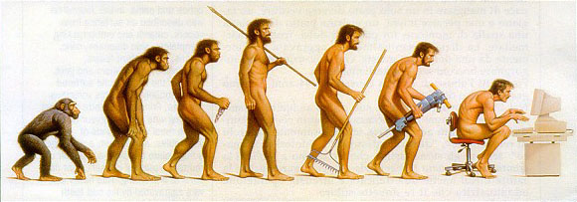
You can‘t stop change from happening
…but you can slow it down (for a while)

Slide 60



Thanks!
Slides: www.cole.de
Mail: tim@cole.de
tc1066
@TCole1066
SuperTimCole
Notes:
In diesem Sinne wünsche ich Ihnen eine zielführende und ergebnisorientierte Diskussion, stimulierende Gespräche und einen wunderschönen und anregenden Abend.

